Slide 1

Quiz game

Slide 2


Communication
Trello
Messenger

Slide 3
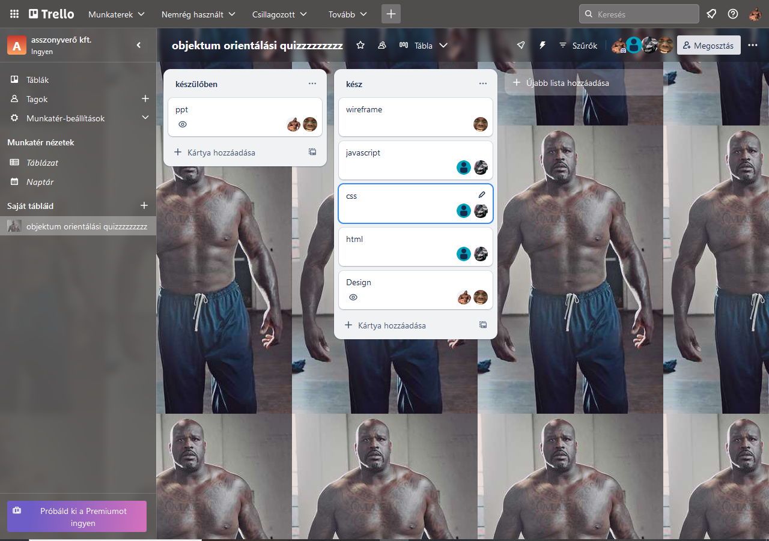
Work schedule
Kispál Marcell - Trello, english ppt
Balogh Ádám - code
Dunai Krisztián – code project leader
Jakab Máté – hungarian ppt.
Design

Slide 4
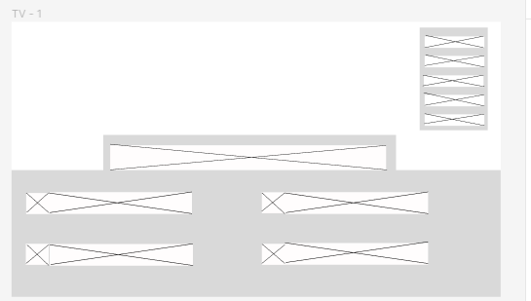
The Wireframe
Made by: Jakab Máté

Slide 5
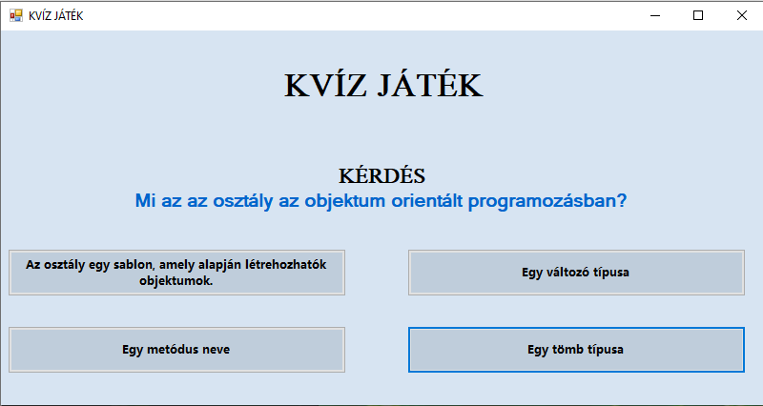
Final version
Made by: Dunai Krisztián
És
Balogh Ádám

Slide 6
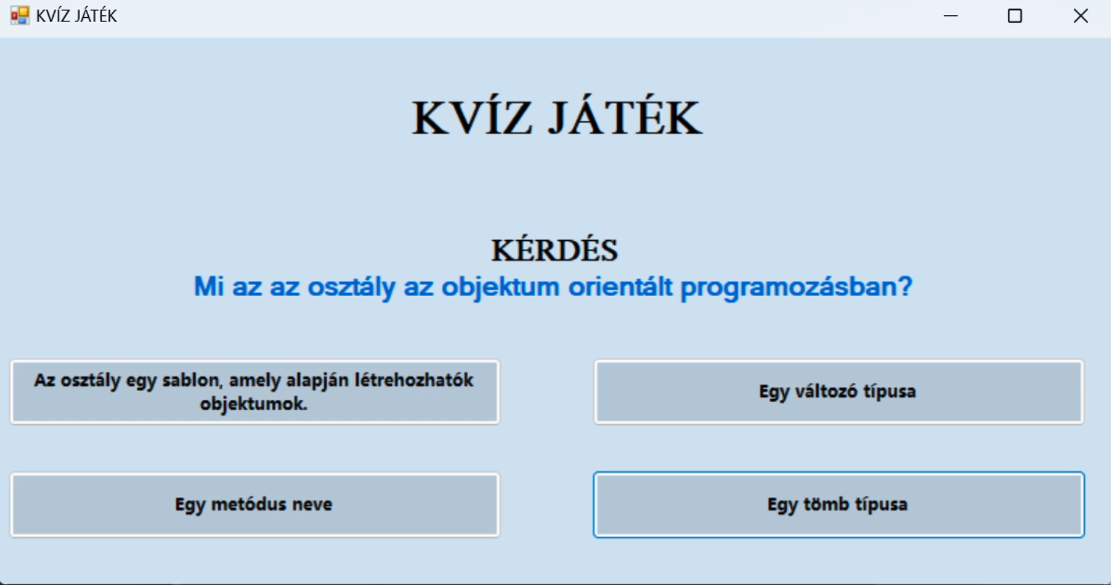

Slide 7
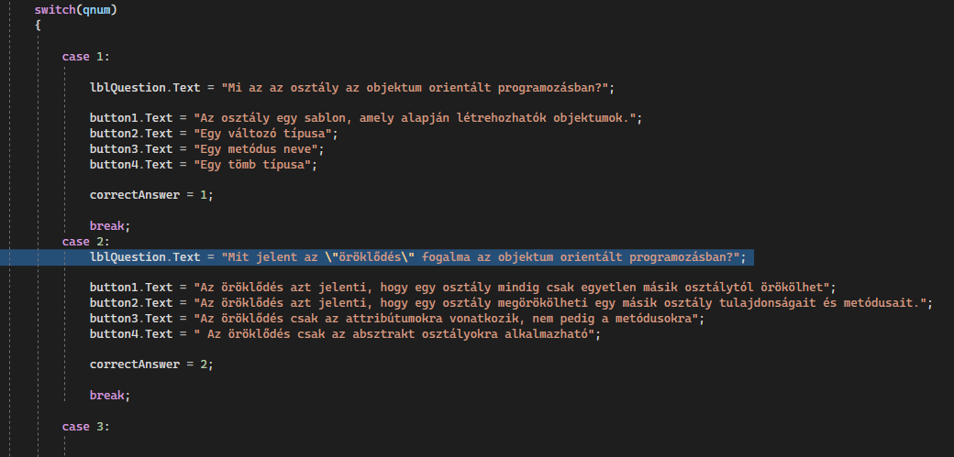
Code

Slide 8
Projekt members:
Dunai Krisztián
Balogh Ádám
Kispál Marcell
Jakab Máté

Slide 9
Thanks for your attention!

